Slide 1

IOT Mini Project Presentation On Topic
“TIC TAC TOE GAME”
Submitted in the partial fulfillment of the
MASTER IN COMPUTER APPLICATION
By
ARUNABH DAS
Enrollment No : AJU/221788
Roll No : 26
Under the esteemed guidance of
Dr. Arvind Kumar Pandey
(DEAN)
&
Akash Kumar Bhagat
(Internal Guide)
DEPARTMENT OF COMPUTER SCIENCE & INFORMATION TECHNOLOGY
ARKA JAIN UNIVERSITY, JHARKHAND
JAMSHEDPUR
2022-2024

Slide 2
PRESENTATION AGENDA
ABSTRACT
PROPOSED MODEL
CIRCUIT DIAGRAM
SCHEMATIC VIEW
PROTOTYPING & WORKING
CONCLUSION
END PAGE

Slide 3
ABSTRACT
The provided Arduino sketch implements a “Tic Tac Toe Game” with a graphical user interface on an LCD display. The game allows a player to interact with the system using two buttons to navigate and select moves. The computer opponent employs a basic artificial intelligence algorithm to make strategic moves. Graphics routines enable the rendering of X and O symbols on the LCD screen, enhancing the user experience.
The game logic is implemented in C++ and manages the state of the Tic Tac Toe grid, checking for wins or ties after each move. The computer opponent's decision-making process considers potential player wins and attempts to create winning opportunities for itself. The user interface is designed to be intuitive, and the graphical representation on the LCD enhances the gameplay experience.
Overall, this Arduino project demonstrates the integration of hardware input (buttons) and output (LCD display) to create an interactive and engaging gaming experience. It serves as a practical example of combining game logic, simple artificial intelligence, and graphical representation on an embedded system.

Slide 4
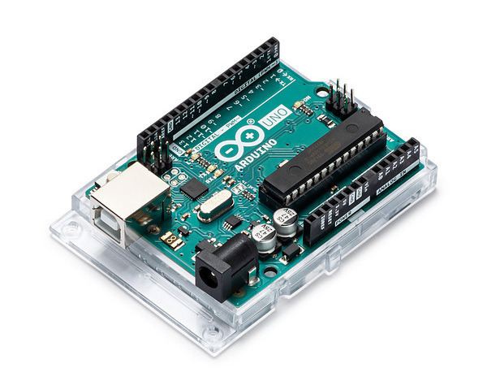
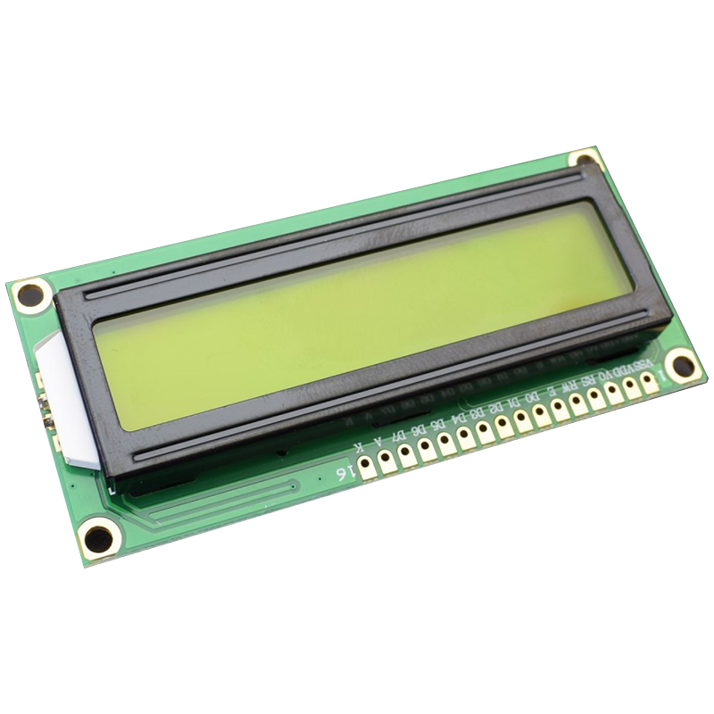
PROPOSED MODEL
HARDWARE REQUIREMENTS :
ARDUINO UNO R3 ->
The Arduino Uno R3 is a popular microcontroller board based on the ATmega328P microcontroller. It is part of the Arduino family of open-source hardware and software products designed for hobbyists, makers, and professionals interested in creating interactive projects.
LCD 16 x 2 ->
An LCD 16x2 (16 characters by 2 lines) is a common type of alphanumeric liquid crystal display that you can use with microcontrollers like the Arduino. The "16x2" notation indicates that the display has 16 characters in each of its two lines.

Slide 5
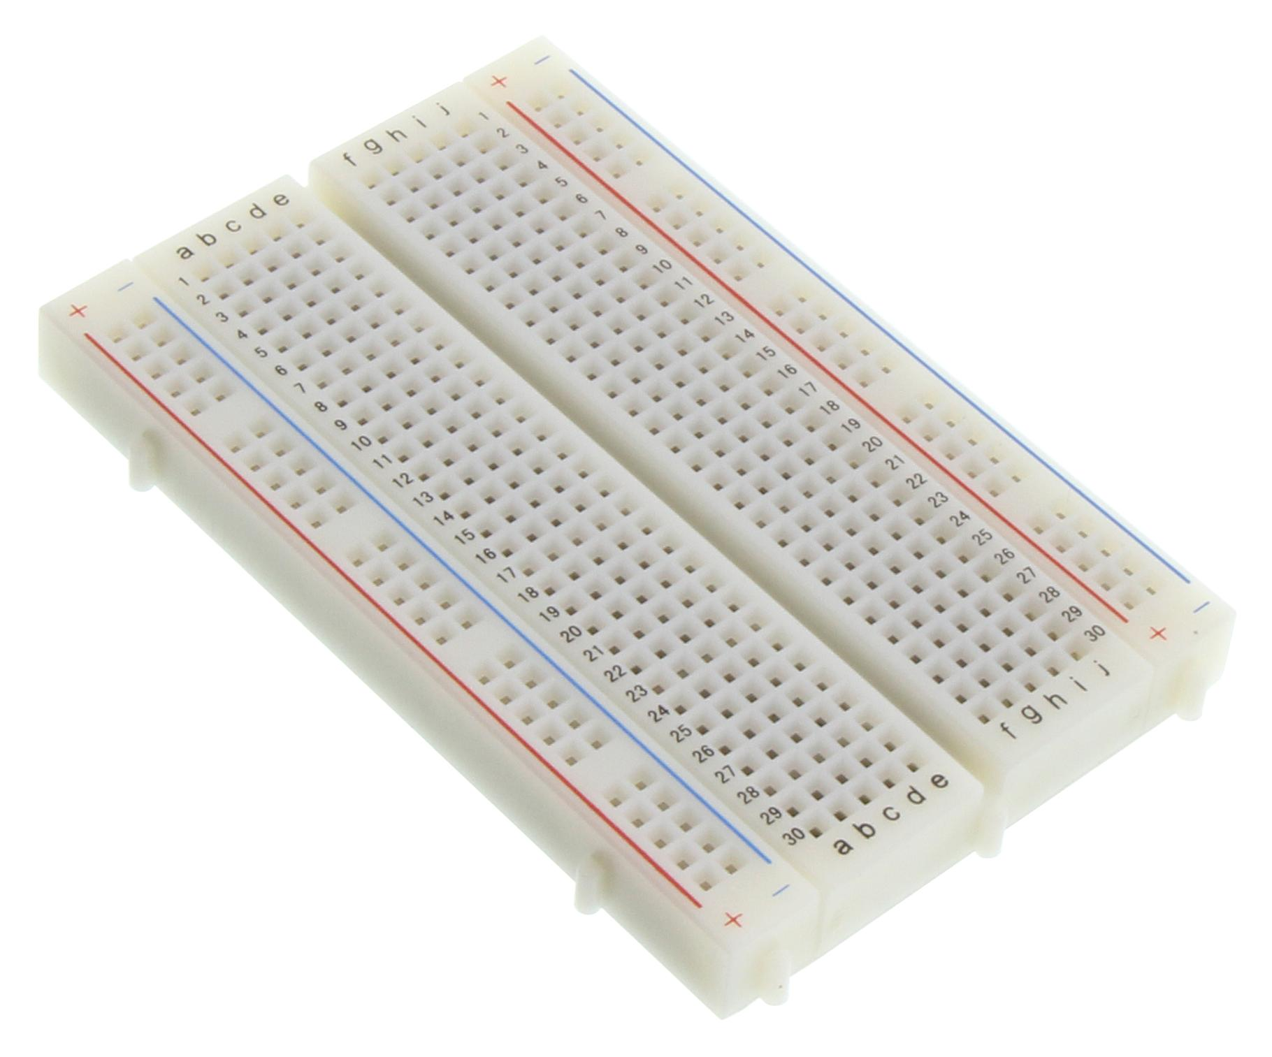
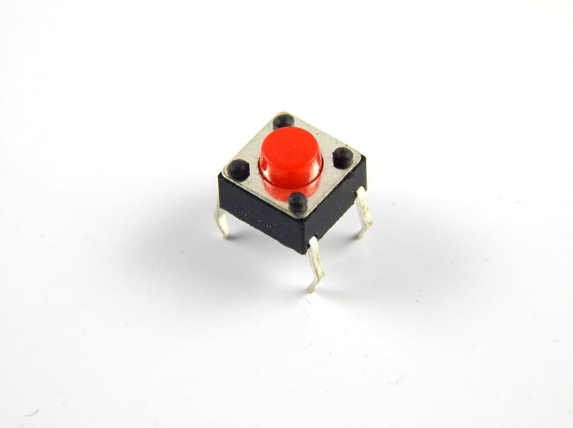
BreadBoard ->
A breadboard is a fundamental tool in electronics prototyping and experimentation. It provides a way to build and test electronic circuits without soldering. Breadboards have a grid of holes into which you can insert and connect electronic components like resistors, LEDs, integrated circuits, and wires.
Push Button ->
A push button is a simple yet commonly used electronic component that acts as a switch. When you press the button, it completes an electrical circuit, allowing current to flow. When you release the button, the circuit is broken, and current stops flowing.

Slide 6
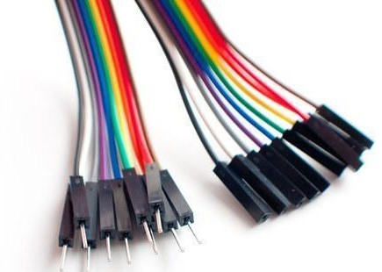
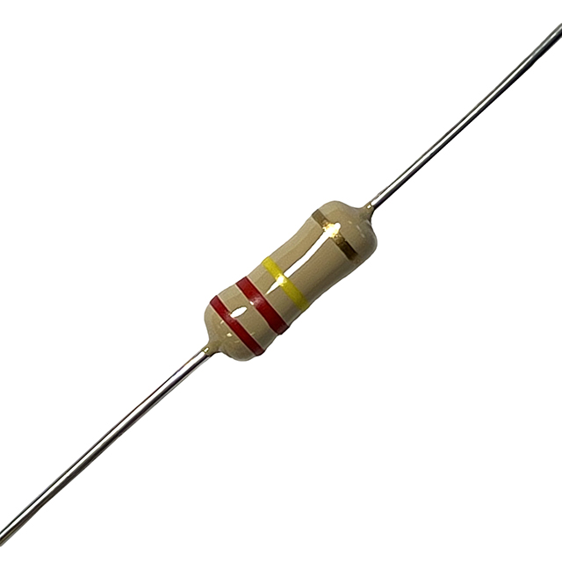
Jumper Wire ->
Jumper wires are essential components in electronics and prototyping. They are used to create electrical connections between various components on a breadboard or between different parts of a circuit.
1k Resistor ->
A resistor is a passive electronic component that limits or controls the flow of electric current in a circuit. Resistors are widely used in electronic circuits for various purposes, including setting bias points, dividing voltages, and limiting current to protect components.

Slide 7
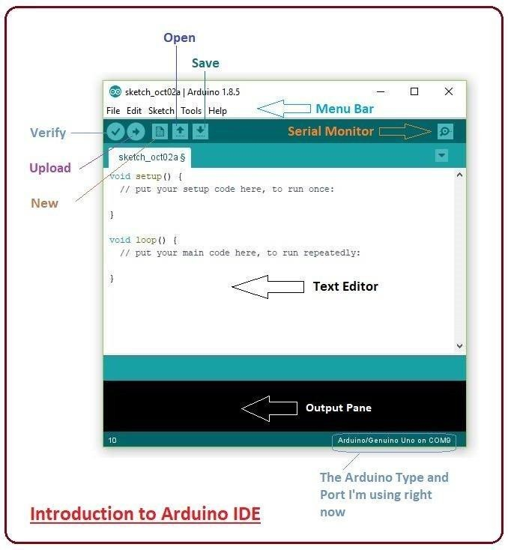
SOFTWARE REQUIREMENTS :
Arduino.cc that is mainly used for writing, compiling and uploading the code in almost all Arduino modules/boards. Arduino IDE is open-source software and is easily available to download & install from Arduino's Official Site.
Arduino IDE is an open-source software, designed by Arduino.cc and mainly used for writing, compiling & uploading code to almost all Arduino Modules.
It is an official Arduino software, making code compilation too easy that even a common person with no prior technical knowledge can get their feet wet with the learning process.
It is available for all operating systems i.e., MAC, Windows, Linux and runs on the Java Platform that comes with inbuilt functions and commands that play a vital role in debugging, editing and compiling the code.

Slide 8
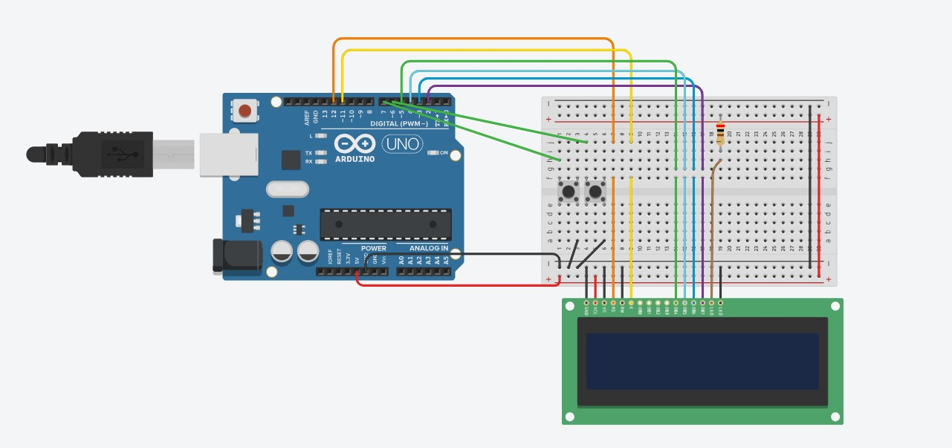
CIRCUIT DIAGRAM
BUTTONS
LEFT BUTTON (Navigate Button) -> Pin 7
RIGHT BUTTON (HIT Button) -> Pin6
LIQUID CRYSTAL DISPLAY
LCD RS(Register Select) -> Pin 12
LCD (Enable) -> Pin 11
LCD D4 -> Pin 5
LCD D5 -> Pin 4
LCD D6 -> Pin 3
LCD D7 -> Pin 2
LCD VCC -> 5V
LCD GND -> GND

Slide 9
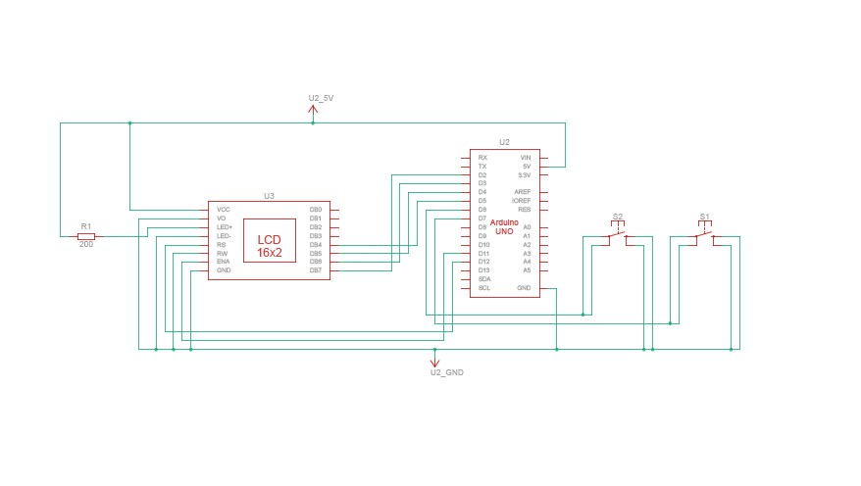
SCHEMATIC VIEW

Slide 10
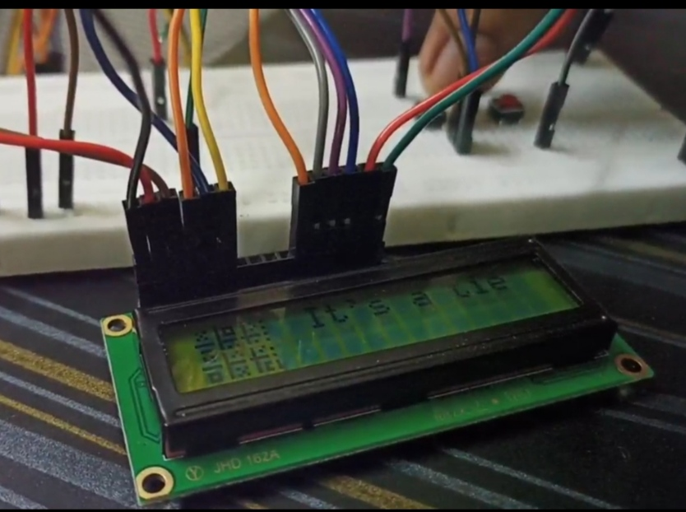
PROTOTYPING & WORKING
The Arduino code initializes the LCD and handles the game logic. It establishes a virtual Tic Tac Toe grid, monitors player button presses to record moves, and checks for win conditions or a draw after each move. The LCD dynamically updates to reflect the current state of the game, displaying the grid and player turns.
During gameplay, players take turns pressing the push buttons to place their respective marks (X or O) on the grid. The Arduino code ensures that each move is processed correctly, updating the internal game state and checking for a winner or a draw. Visual feedback is provided on the LCD, making the game interactive and engaging.

Slide 11
CONCLUSION
In conclusion, the Tic Tac Toe IoT project represents a successful integration of hardware and software components, creating an engaging and educational gaming experience. By leveraging Arduino Uno, a 16x2 LCD display, and push buttons, the project introduces users to the fundamentals of electronics, microcontroller programming, and the Internet of Things (IoT). The interactive nature of the game, with players making moves through physical buttons and receiving real-time feedback on the LCD, enhances the overall learning experience.
The project's adaptability allows for customization and future expansion, offering avenues for advanced features such as cloud connectivity, online multiplayer capabilities, and integration with other IoT devices. Its low-cost hardware and simplicity make it accessible to a wide audience, making it an ideal tool for teaching and learning.

Slide 12
THANK YOU!
MASTERS IN COMPUTER APPLICATION
SEM – 3rd
Name : Arunabh Das
Enrolment No : AJU/221788

